Slide 1

Module 4 –Streaming Algorithms

Slide 2


BIG DATA
Exercise 5
Suppose we have a Kafka system
1 topic
3 servers
3 partitions
3 replicas per partition
Consumer group with 3 instances
Draw a diagram showing
Servers
Partitions
Consumer instances
Partition assignments

Slide 3
BIG DATA
Exercise 5 (Solution)
Suppose we have a Kafka system
1 topic
3 servers
3 partitions
3 replicas per partition
Consumer group with 3 instances
Draw a diagram showing
Servers
Partitions
Consumer instances
Partition assignments
Server 0
Server 1
Server 2
Replicas
P1
P2
P0
P2
P0
P1
Leader
P0
P1
P2
Consumer Group
C0
C1
C2

Slide 4
BIG DATA
Issues in stream processing
Velocity of the stream
The rate at which data is being sent
Sometimes requires instantaneous decision.
Different streams may have different rates
For ex: mission critical systems
#streams
Processing multiple streams each requiring a small amount of memory may stress memory system
Stream processor

Slide 5
BIG DATA
Stream processing algorithms
Must process data in memory
Not off disk (too slow)
More efficient to get approximate solution rather than an exact one.
Often use hashing techniques to introduce randomness
Stream processor

Slide 6
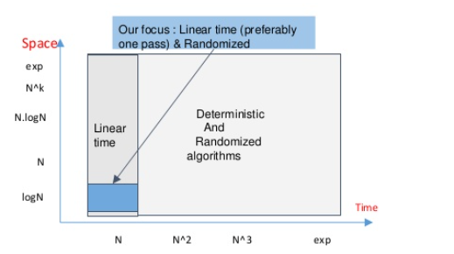
Streaming Algorithms
Why and how are they different?
Extract maximum information
in minimal space and time

Slide 7
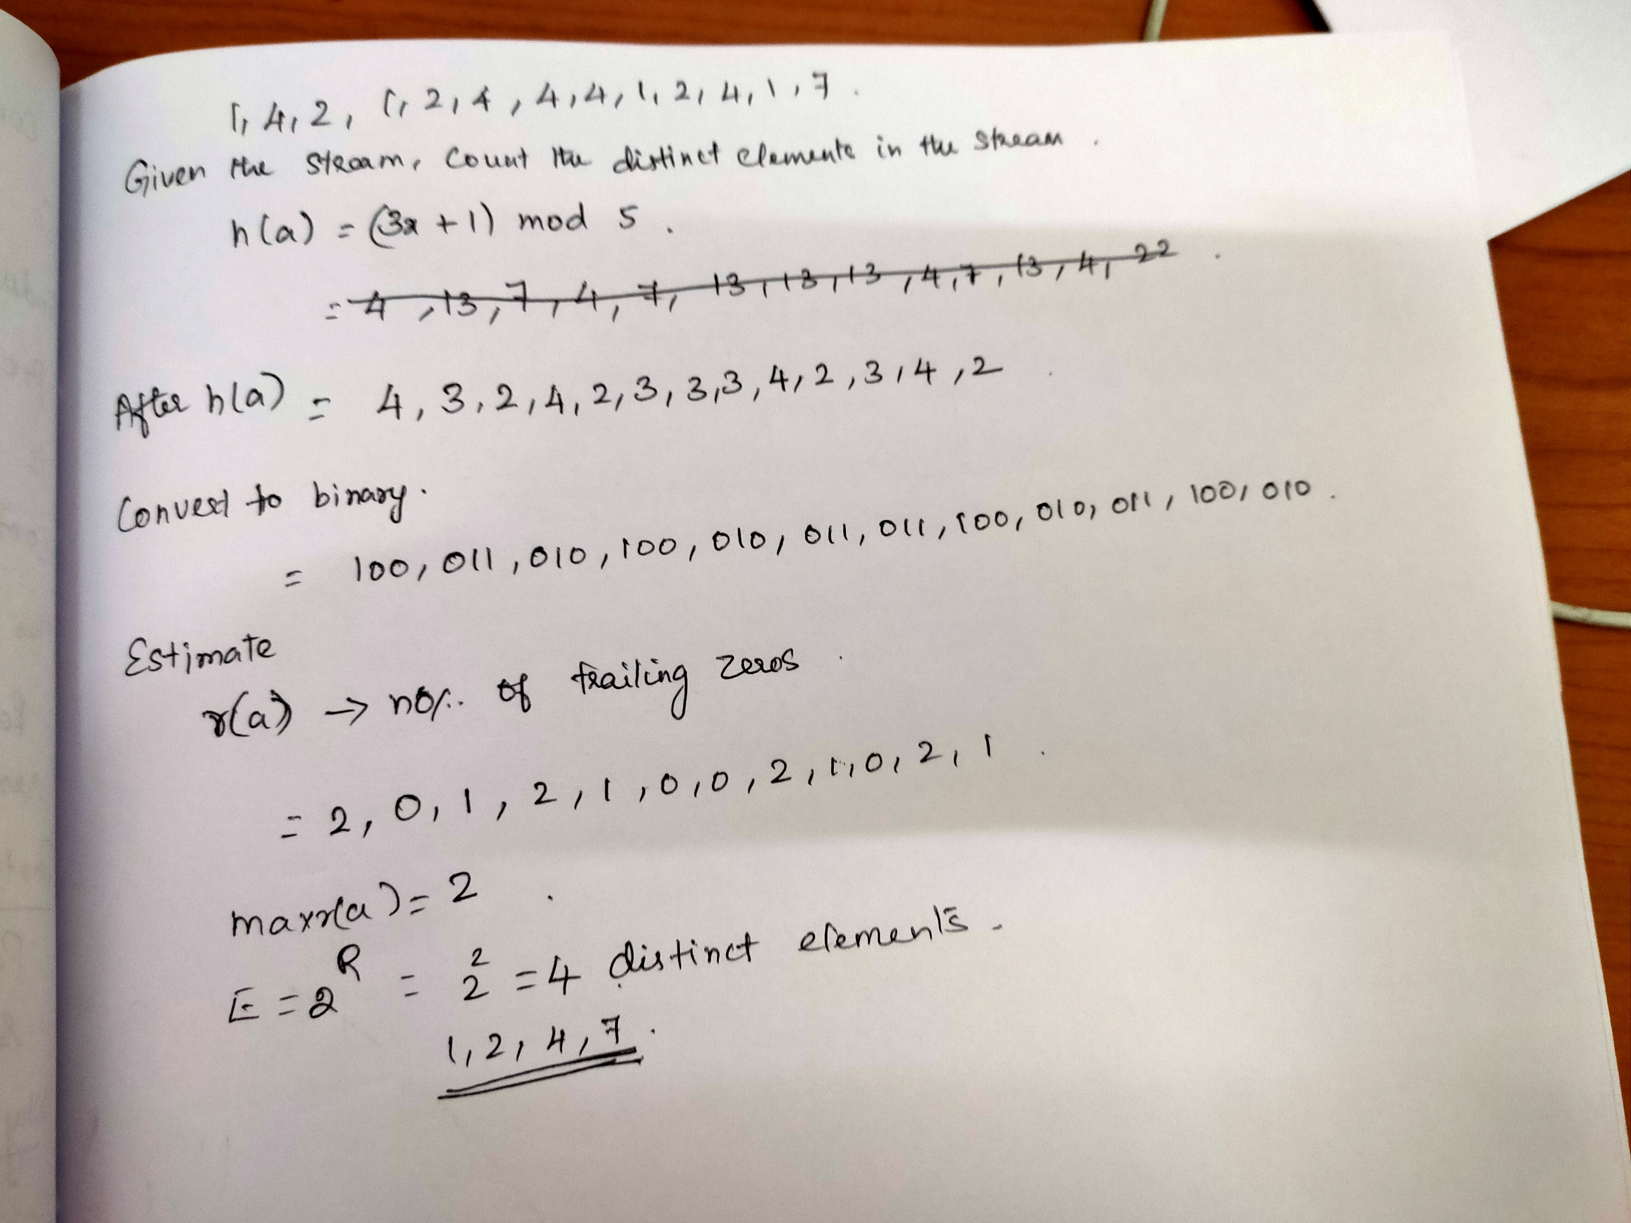
Streaming Algorithms
Cardinality- Number of distinct items in a stream in one pass

Slide 8
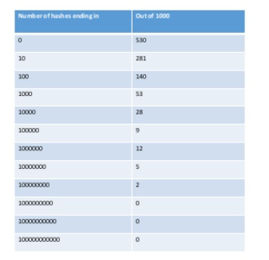
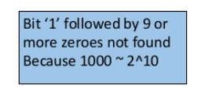
Streaming Algorithms
Flajolet Martin Algorithm-Bit Patterns

Slide 9
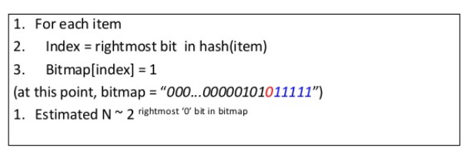
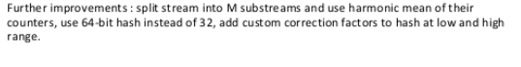
Streaming Algorithms
Flajolet Martin Algorithm

Slide 10
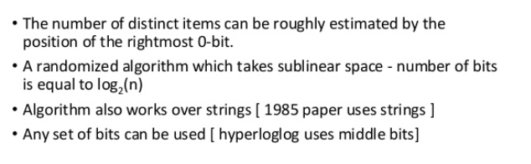
Streaming Algorithms
Flajolet Martin Algorithm- Why this works?

Slide 11
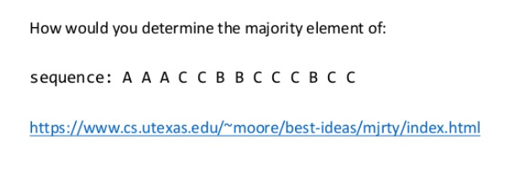
Streaming Algorithms
Heavy Hitters Problem

Slide 12
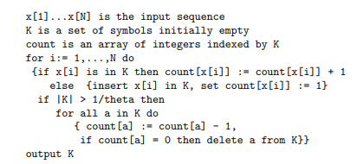
Streaming Algorithms
Karp-Papadimitriou-Shenker algorithm

Slide 13
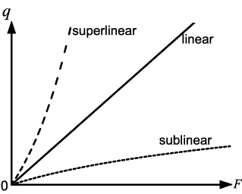
Streaming Algorithms
Count-min Sketch
Consumes Sublinear
Direct relationship

Slide 14
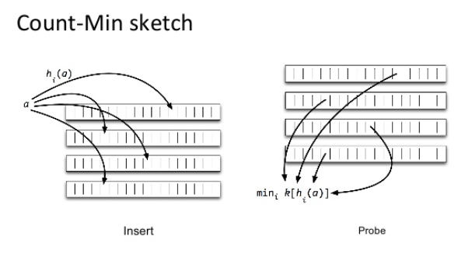
Streaming Algorithms
Count-Min Sketch

Slide 15
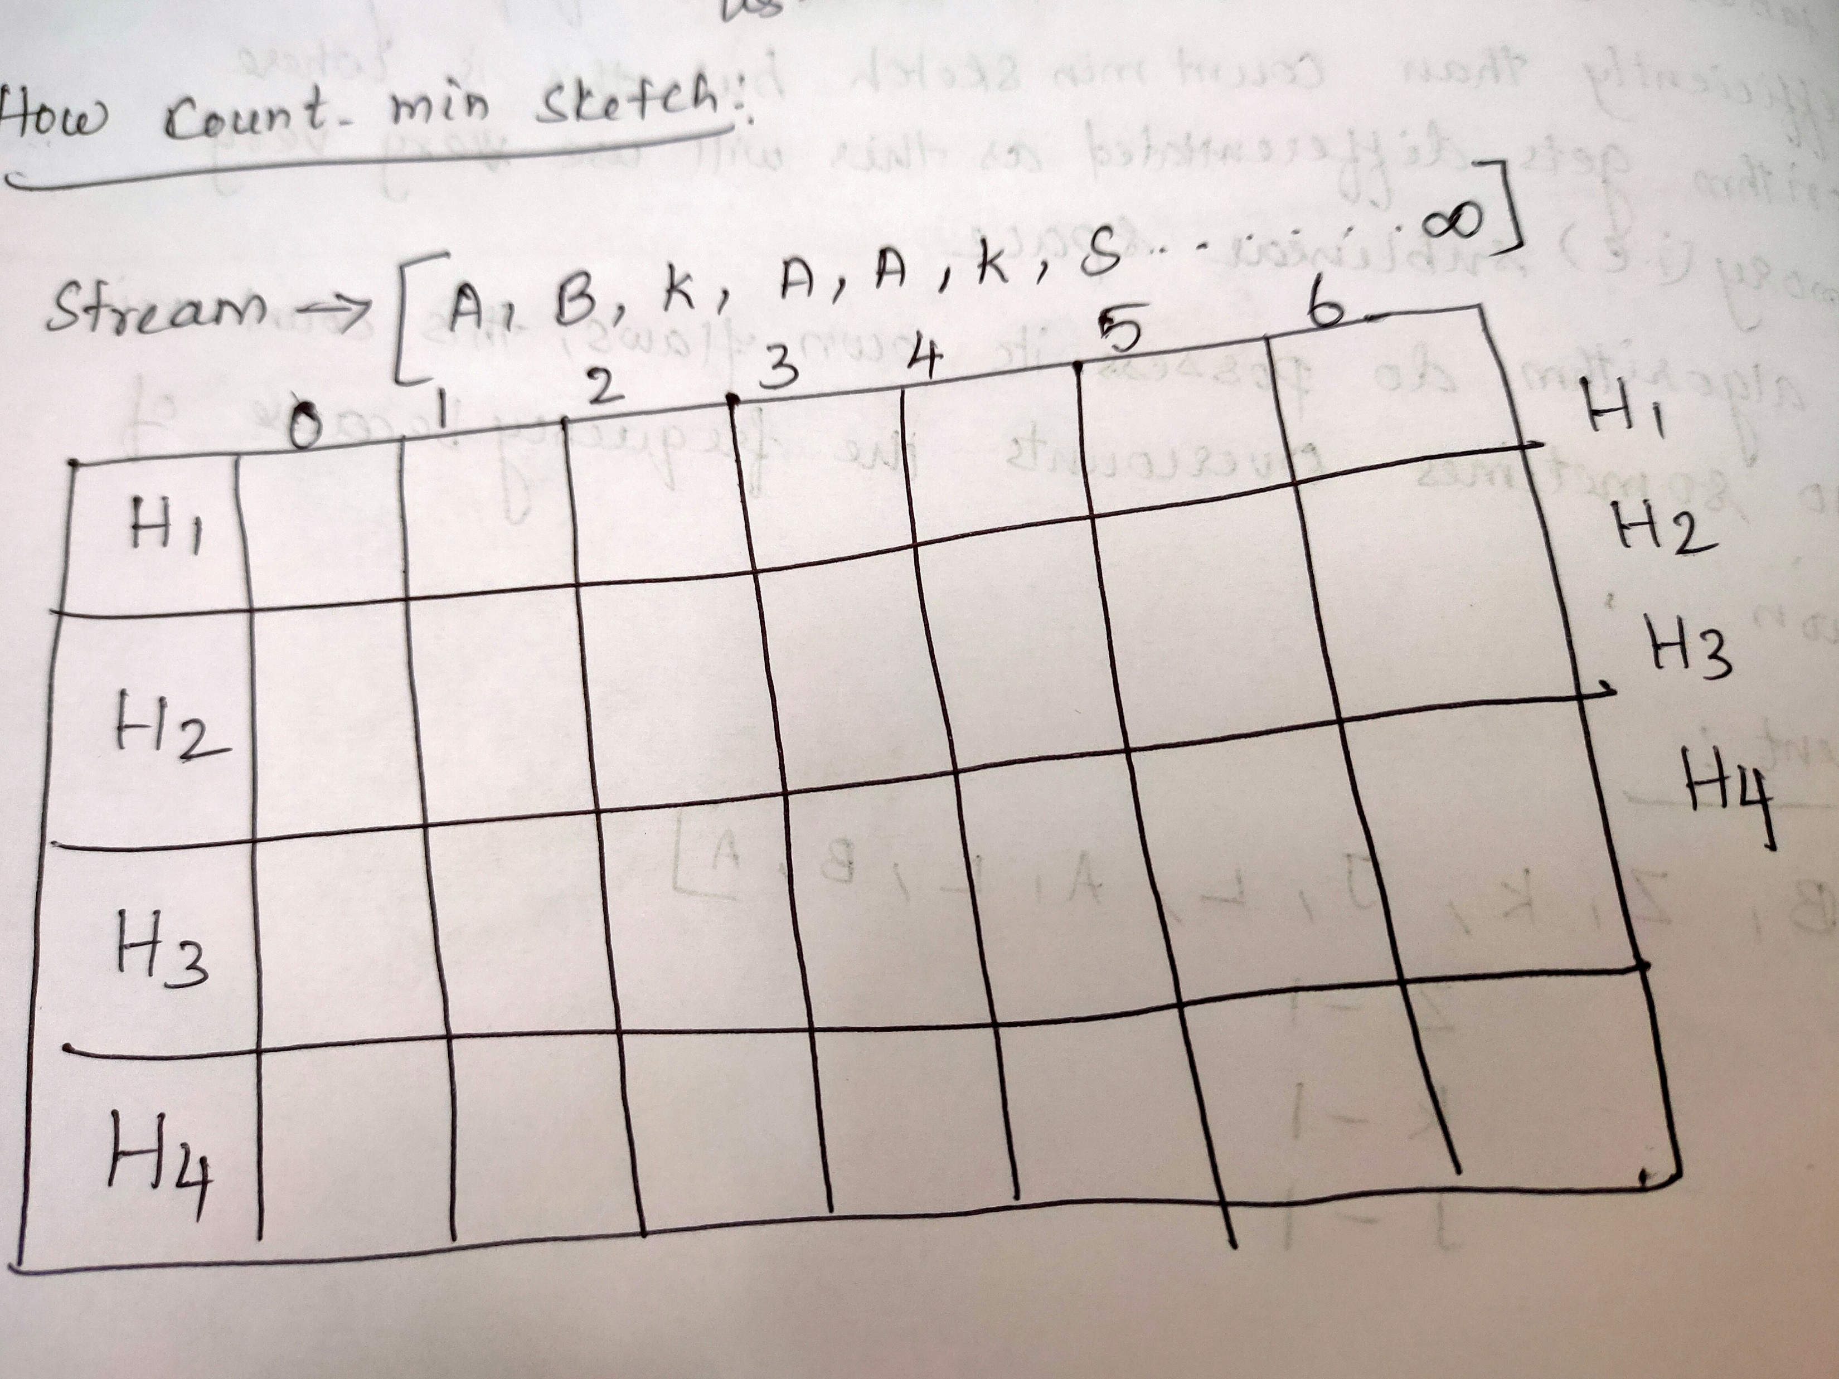
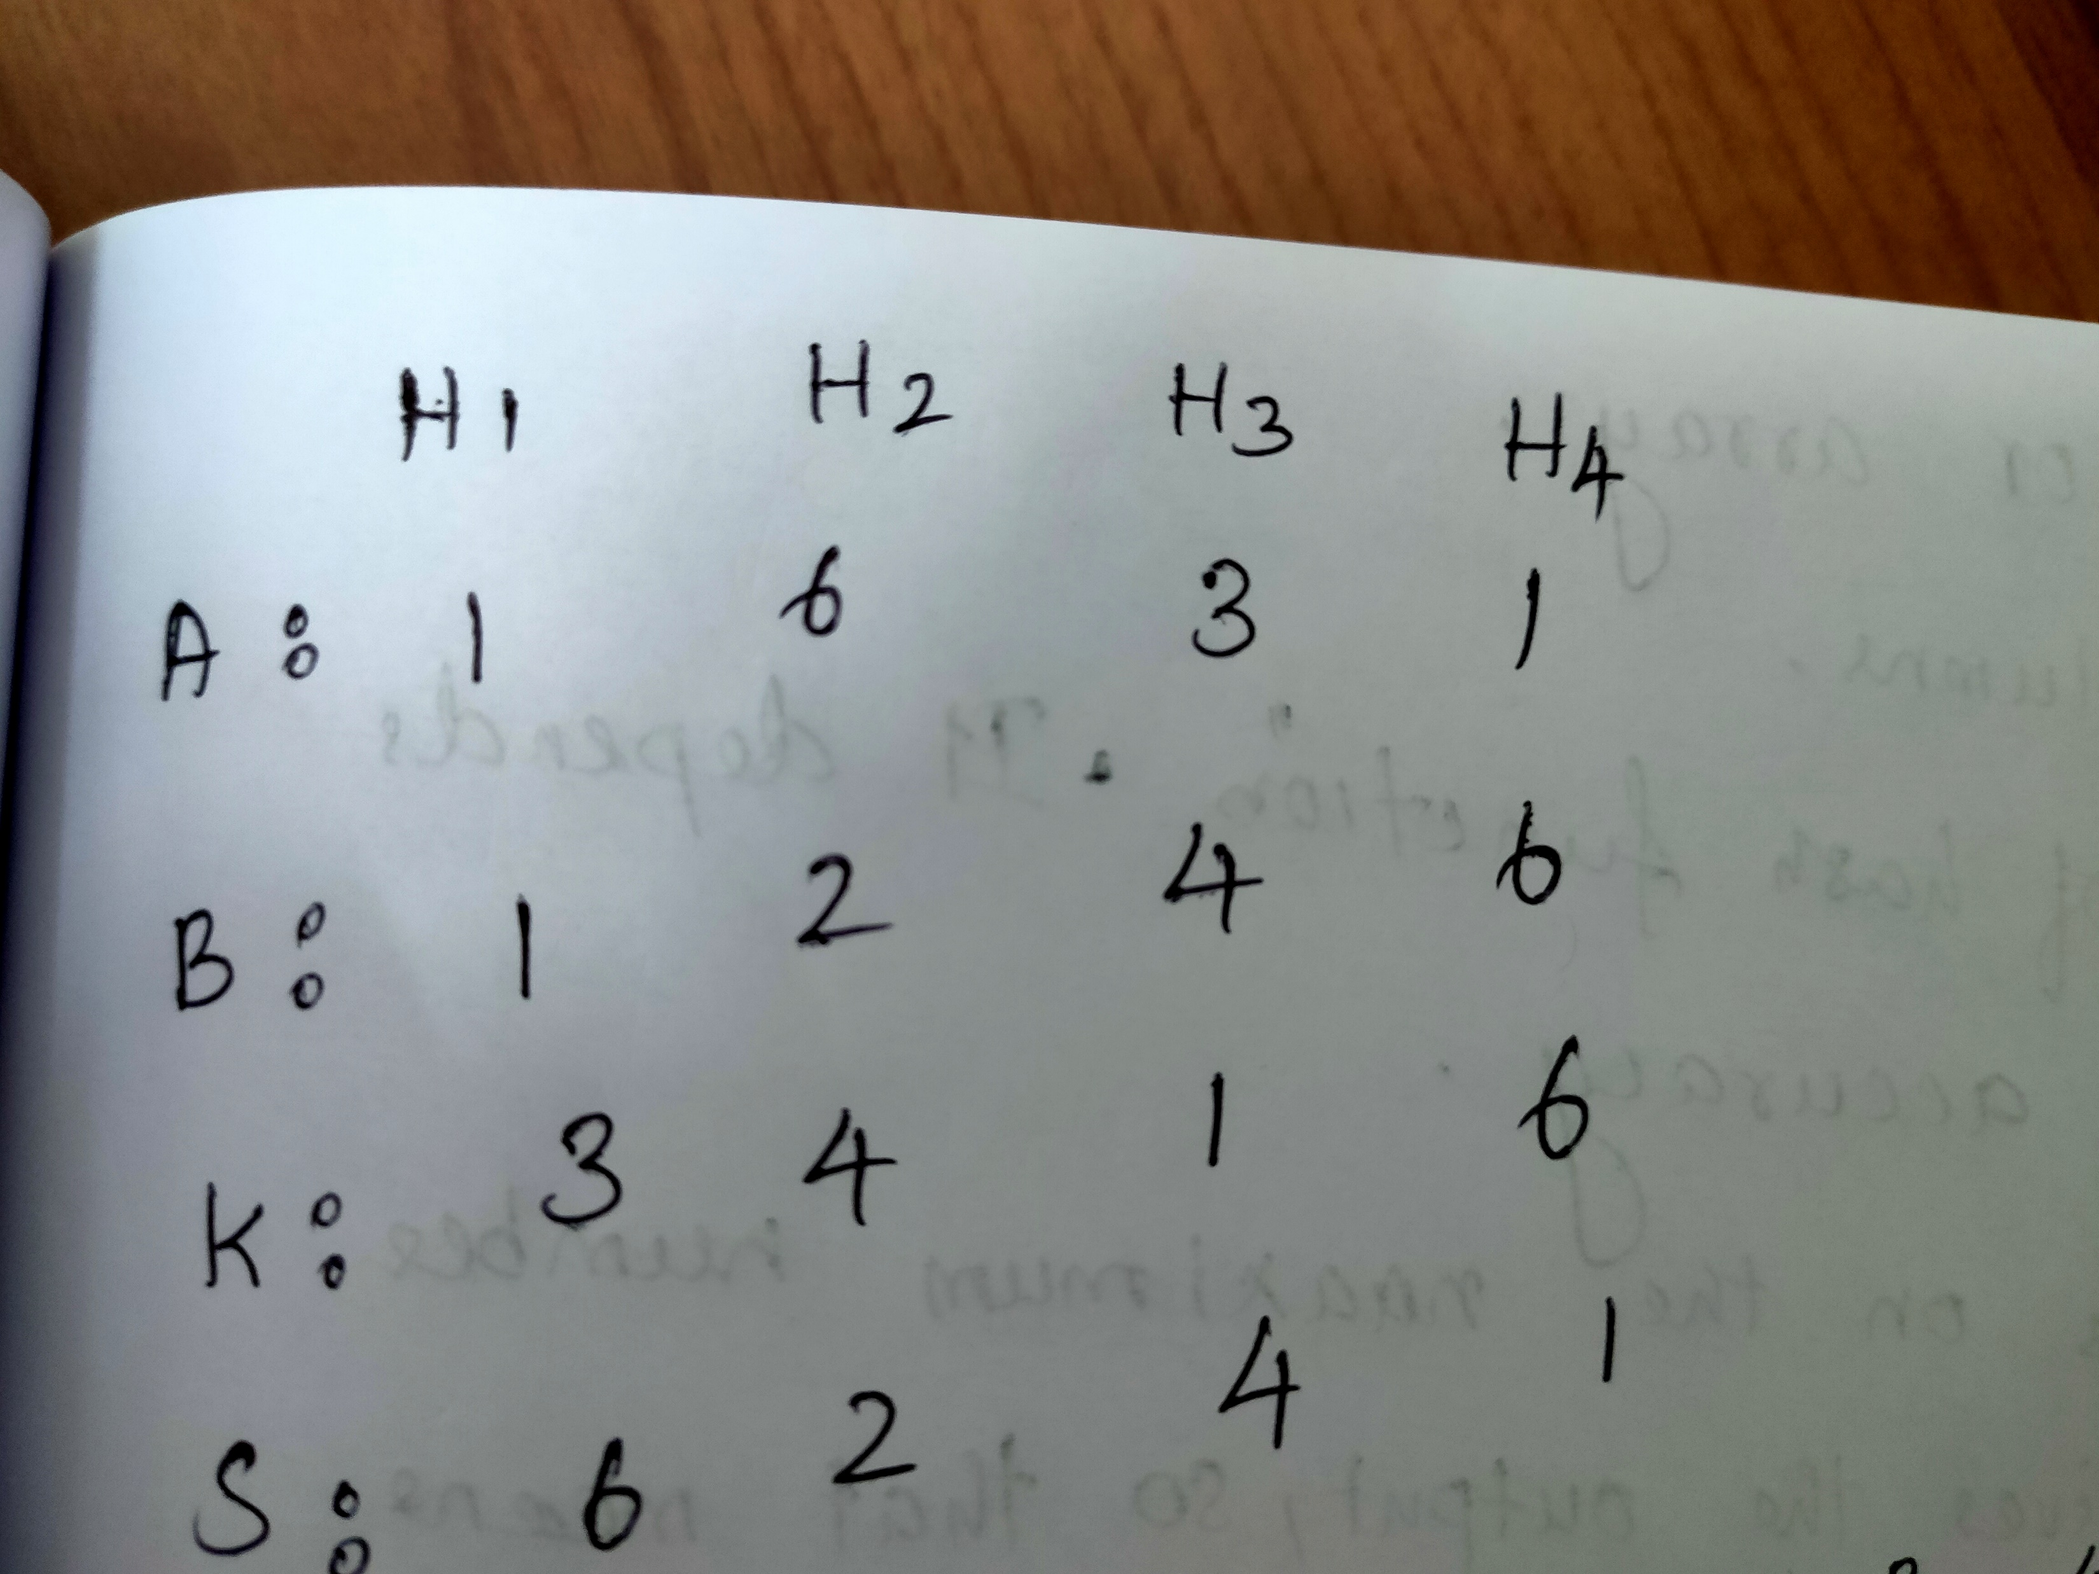
Streaming Algorithms
Count-Min Sketch

Slide 16
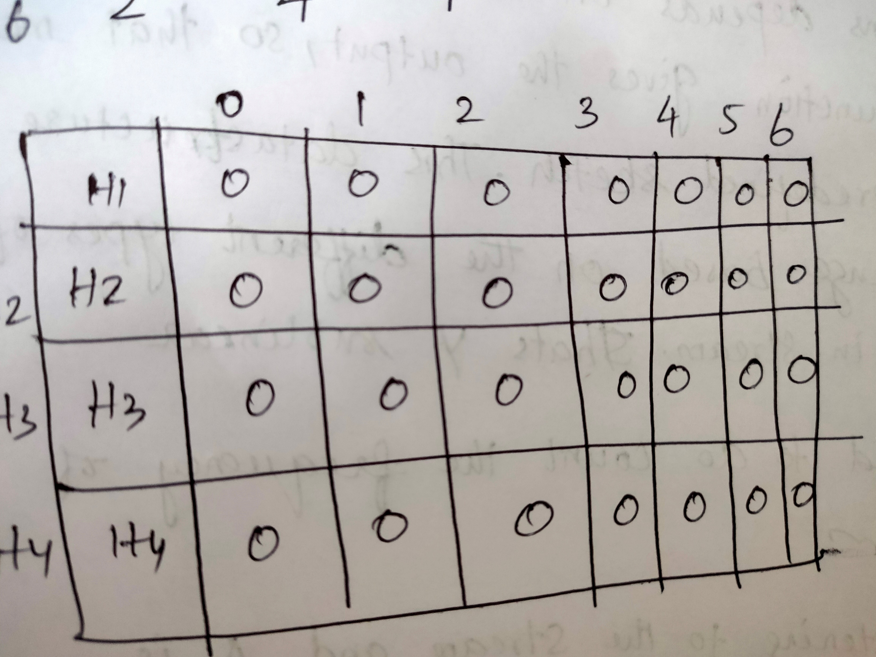
Streaming Algorithms
Count-Min Sketch

Slide 17
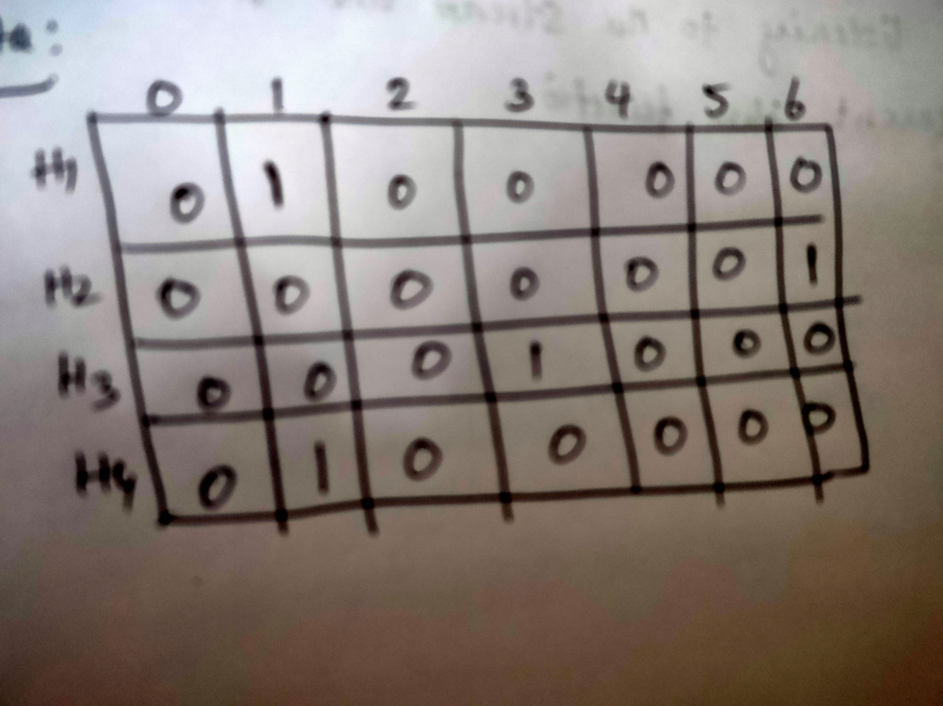
Streaming Algorithms
Count-Min Sketch

Slide 18
BIG DATA
Filtering Data
Sometimes we need to take a decision
To filter out certain events
The decision has to be taken instanteously
Large number of events need to be processed.
Stream of events
Filtered events
Source
Stream Processing
Based on some criteria, we want to keep only a few events

Slide 19
BIG DATA
Filtering Data – Motivational example
Incoming email
Remove all spam emails
Constraints
1GB of main memory
1 billion non-spam email ids (well known)
20 bytes/email address
Can’t store all email ids in memory
Disk is a slow store
Stream of emails
Non-spam emails
Source
Spam processing
We want to identify the spam messages and filter them out.

Slide 20
BIG DATA
The need for processing events
One approach
Breakup stream into a window of events
Window size n
Allows us to perform relational operations
Similar to Apache Spark model
Client
Stream of events
Stream Processing
Typically we need to summarize the information in the stream

Slide 21
THANK YOU

